Slide 1
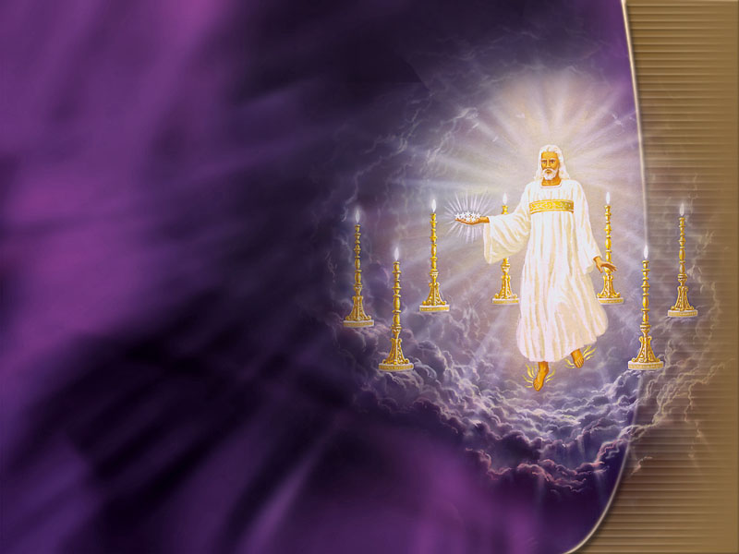
WELCOME
TO
SHORTWOOD
SEVENTH-DAY ADVENTIST
CHURCH
“SEARCH THE SCRIPTURE FOR IN THEM YE THINK YE HAVE ETERNAL LIFE”
CRUSADE 2016
“AT THE TIME APPOINTED THE END SHALL COME”

Slide 2
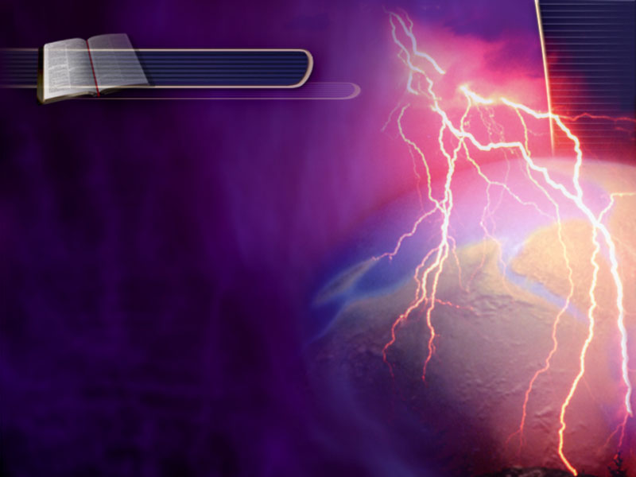
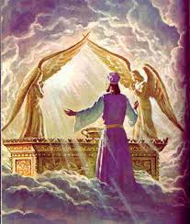
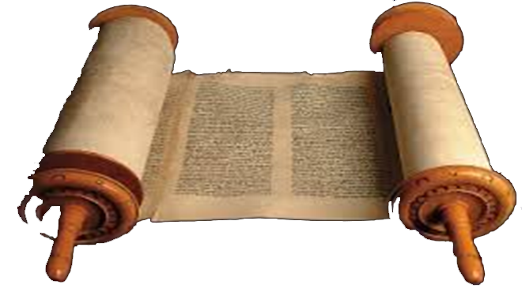
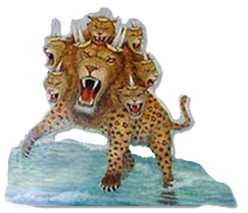
“AT THE TIME APPOINTED
THE END SHALL COME”

Slide 3
GOD’S METHOD TO STUDY
Isaiah
Joel
Whom shall he teach knowledge?
and whom shall he make to understand doctrine?… But the word of the Lord was unto them
(1) precept upon precept, [Instruction]
precept upon precept; [set in order]
(2) line upon line, line upon line;
(3) here a little, and there a little…
Isa 28:9-13
Zepheniah
Revelation
AT THE TIME APPOINTED …
Amos

Slide 4
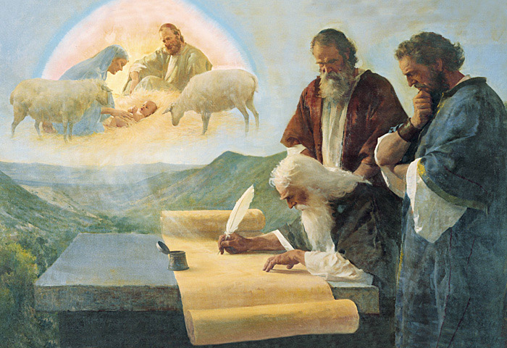
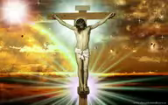
PURPOSE OF THE PROPHET
Hos 12:10 I have also spoken by the prophets, and I have multiplied visions, [revelation] and used similitudes, by the ministry of the prophets.
 SIMILITUDES: Compare, resemble, parable, model
Hos 12:13 And by a prophet the LORD brought Israel out of Egypt, and by a prophet was he preserved [protected].

Slide 5
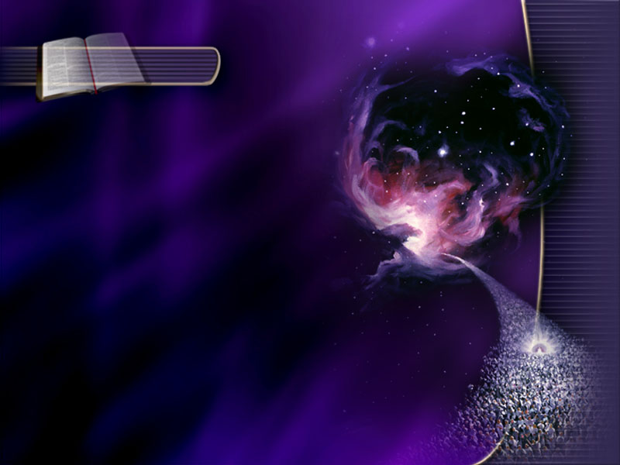
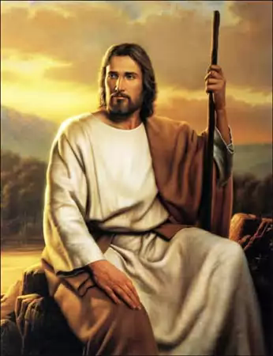
VISIONS AND DOCTRINES
Where there is no vision,[revelation] the people perish: but he that keepeth the law, happy is he. Pro29:18.
Mar 4:2 And he taught them many things by parables [similitude], and said unto them in his doctrine…
WRITE THE VISION, AND MAKE IT PLAIN…
THAT HE MAY RUN THAT READETH IT.
Hab.2:2

Slide 6
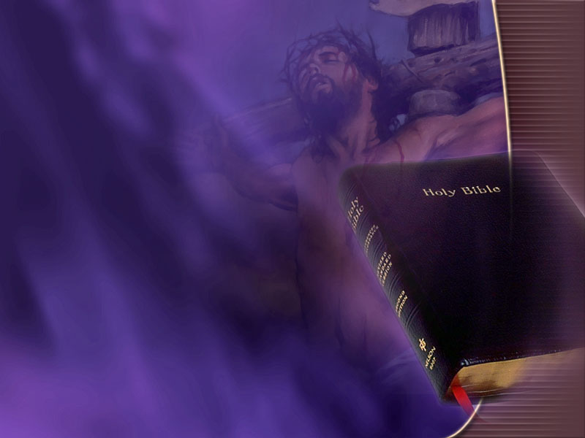
TIME TO PAUSE AND REFLECT
“TODAY IF YOU WILL HEAR HIS VOICE HARDEN NOT YOUR HEARTS”-Heb. 4:7

Slide 7
July
FIRST WEEK:
Sun. At the Time Appointed
Mon. Why Tomorrow will be Too Late
Thus. Blood, Blisters and Bloody Water
Wed. The Man with the Keys of Death
Thurs. Sex and the Single Girl
“We must not think, "Well, we have all the truth, we understand the main pillars of our faith, and we may rest on this knowledge. The truth is an advancing truth, and we must walk in the increasing light.”
- {Counsels to Writers & Editors 33.2}

Slide 8
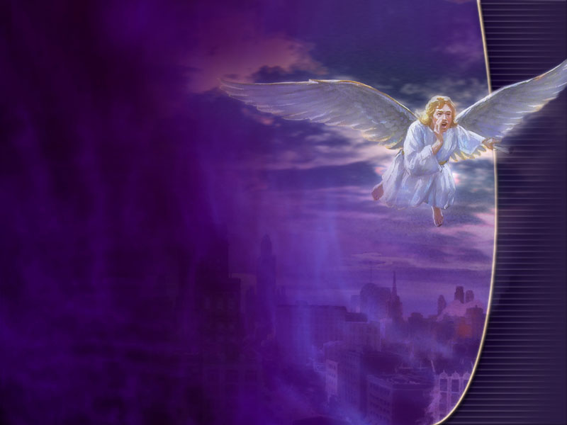
August
SECOND WEEK:
Sun. Are you Seal or Mark? How to know.
Mon. For such a Time as This
Tues. Divide and Conquer
Wed. Where will you Spend Eternity
Thurs. Dress it and Keep it
“There are many precious truths contained in the Word of God, but it is "present truth" that the flock needs now.”
- {Early Writings pg. 63}

Slide 9
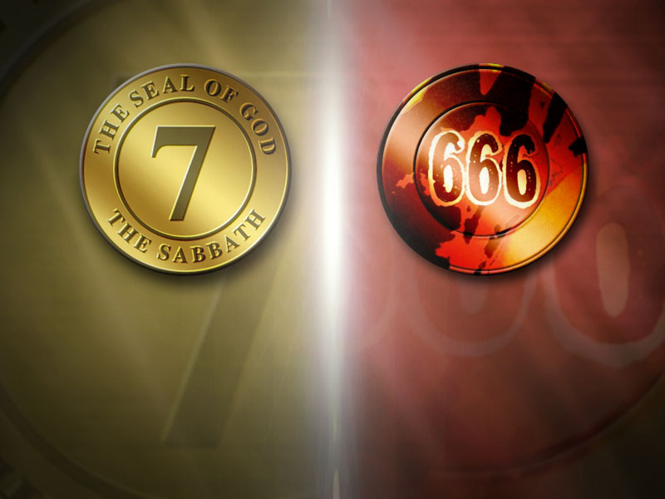
August
THIRD WEEK:
Sun. Rise Peter Kill and Eat
Mon. How Art Thou Fallen?
Tues. Identifying the Beast, Avoiding the Number
Wed. When God Says Remember
Thurs. How to Keep the Honey and Spend the Money
“Those who accept the present truth and are sanctified through it have an intense desire to represent the truth in their life and character. They have a deep yearning of soul that others may see the light and rejoice in it. As the true watchman goes forth…from time to time fresh supplies of things new and old need to be brought forth from the storehouse of God's word..”- {Counsels on Health pg. 564}

Slide 10
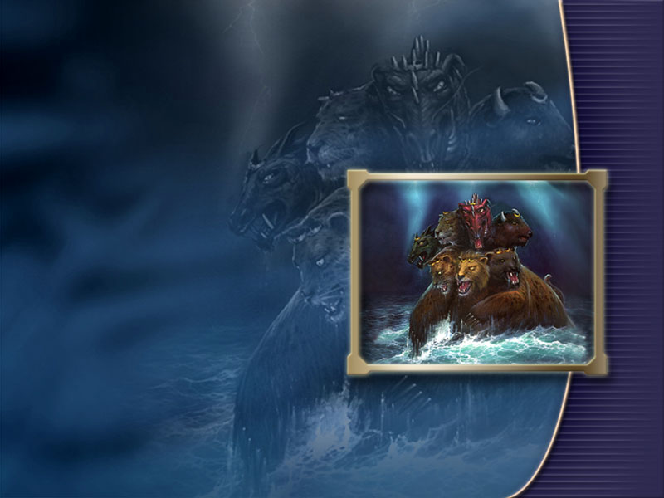
August
FOURTH WEEK:
Sun. Victory within Reach, How to Claim it
Mon. What was Nailed to the Cross
Tues. Be not Deceive, Recognized the Counterfeit
Wed. God Set a date for the Judgment, When?
Thurs. Goozum - The Duppy Remedy
“It is not in the order of God that light has been kept from our people,--the very present truth which they needed for this time.”- {Christian Service pg. 163}

Slide 11
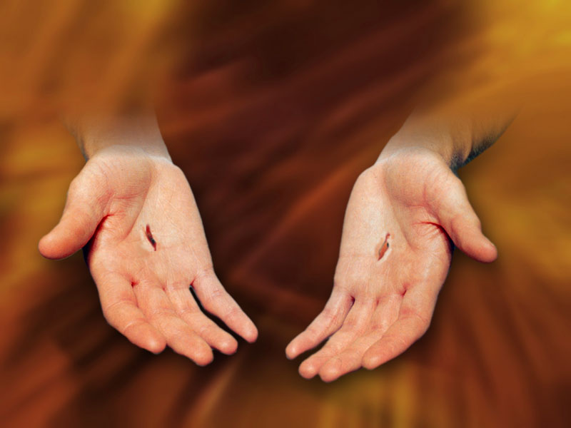
JESUS LOVES YOU THIS MUCH

